Slide 1
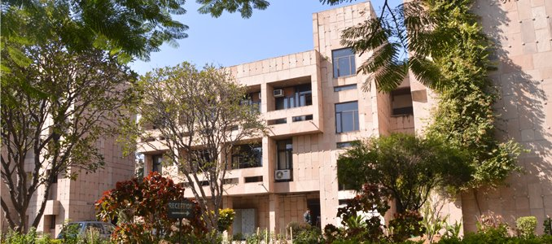
How is India Doing?
Mid Year Macroeconomic Review
Panelists: Rudrani Bhattacharya, Radhika Pandey & Manish Gupta
In Conversation with
Sudipto Mundle
Center for Development Studies
National Institute of Public Finance and Policy
August 11, 2023

Slide 2
Part I
Growth

Slide 3
Growth slowed in H2 compared to H1 due to fading base effect and slow down in consumption & investment demand
y.o.y growth (%)
Demand components | 2022-23 | 2022-23 H1 | 2022-23 H2
Aggregate demand (GDP) | 7.2 | 9.5 | 5.3
Govt. Final Consumption Exp. (GFCE) | 0.1 | -0.9 | 1.0
Private Final Consumption Exp. (PFCE) | 7.5 | 13.6 | 2.5
Gross Fixed Capital Formation (GFCF) | 11.4 | 14.7 | 8.5
Exports of Goods & Services (X) | 13.6 | 15.8 | 11.5
Imports of Goods & Services (M) | 17.1 | 28.0 | 7.7
Source: CSO, MOSPI

Slide 4
Growth slowed down mainly in services
y.o.y growth (%)
Sectors | 2022-23 | 2022-23 H1 | 2022-23 H2
GDP | 7.2 | 9.5 | 5.3
1. Agriculture ,forestry & fishing | 4.0 | 2.4 | 5.1
2. Industry 2.1 Mining & Quarrying 2.2 Manufacturing 2.3 Electricity, gas, water supply and other utility 2.4 Construction | 4.4 4.6 1.3 9.0 10.0 | 4.3 5.1 0.9 10.3 10.7 | 4.5 4.2 1.7 7.5 9.5
3. Services 3.1 Trade, hotels, transport, communication, broadcasting (TRC) 3.2 Financial, real estate and professional services 3.3 Public administration, defense and other services (PAD) | 9.5 14.0 7.1 7.2 | 12.6 20.1 7.8 12.6 | 6.5 9.3 6.4 2.6
Source: CSO, MOSPI
H2 Industrial growth led by utility and construction, manufacturing growth remained muted
In Services, high H1 growth halved in H2, growth reduction mainly in TRC and PAD
H1 agricultural growth low due to volatile weather conditions, but robust in H2 due to increase in gross sown area, mainly driven by increase in domestic and global wheat prices

Slide 5
Agricultural growth was probably muted in Q1 23-24
Source: CMIE
Volatile weather conditions
Area sown under Kharif crops 4% lower in Q1 23-24 compared to Q1 22-23
Muted agricultural activity also reflected in low growth of tractor sales

Slide 6
Overall industrial recovery in Q1 of 2023-24
Source: CSO, MOSPI
Robust construction growth rose further during April-May 2023-24
Recovery in manufacturing mainly in consumer non-durables
Hint of possible slowing in May due to lagged transmission of policy rate hike

Slide 7
Services: Slowdown in foreign trade services continuing in Q1 23-24, domestic trade services growth also declined in this quarter
Source: Ministry of ports, shipping & waterways, CMIE

Slide 8
GDP growth forecast at 5.6-6% for FY 23-24
Source: MOSPI; Bhattacharya, Chakravartti and Mundle (2023); Bhattacharya, Bhandari and Mundle (2023)
Growth forecast range derived from high-frequency and annual data models
Comparative forecasts are RBI 6.5%, IMF 6.1% & World Bank 6.3%
Expected growth slow down in FY 23-24 attributable to lagged effect of monetary tightening, and expected global growth slowdown to 3% in 2023, down from 3.5% in 2022 (IMF)

Slide 9
Part II
Inflation

Slide 10
Inflation now below RBI tolerance band upper limit of 6%
Source: CSO, MOSPI

Slide 11
Broad-based inflation decline in all major components of CPI
Source: CSO, MOSPI

Slide 12
FY 23-24 inflation forecast at 5.1%, below RBI tolerance band upper limit
Source: NIPFP
Upside risk: Volatile weather conditions, rebound in oil prices & global food supply disruption
Moderating factors: Continuing effect of monetary policy tightening

Slide 13
Part III
Balance of Payments

Slide 14
Current Account Balance (CAB) improved in H2 22-23 compared to H1 due to decline in trade deficit
Source: RBI, MOSPI, & NIPFP Computations
Trade deficit declined due to contraction in goods trade deficit & increase in services trade surplus in H2
Goods imports declined more than the exports, reducing goods trade deficit

Slide 15
Capital account net inflow fell sharply in H2 22-23, due to contraction in reserve assets and FPI inflows, while FDI and other investment flows remained volatile
Source: RBI, MOSPI & NIPFP Computations
Net financial inflows declined in H2 FY 2022-23 to US$ 18.8 billion from US$ 49.3 billion in H1 FY 2022-23

Slide 16
Trade deficits started widening again in Q1 FY 23-24 due to increase in goods trade deficit & decline in service trade surplus compared to Q4 22-23
-12.2
-32.5
-22.6
Source: RBI, & NIPFP Computations

Slide 17
Foreign Direct Investment was stable while Foreign Portfolio Investment flows peaked in Q1 23-24
Source: RBI & NIPFP Computations
Source: National Securities Depository Limited (NSDL), & NIPFP

Slide 18
Nominal exchange rate depreciated till Q3 then stabilized while REER appreciated through H2, then depreciated
Source: RBI & NIPFP Computations
Nominal exchange rate movements correlated with change in reserves
Foreign exchange reserves as on July 3, 2023 is sufficient to cover 9.7 months of projected imports for FY 23-24

Slide 19
Part IV
Fiscal Outlook:
Central and State Governments

Slide 20
Central Government: Tax revenues buoyant since 2019-20, sharp dip in Q1 2023-24
Revenue Collections 2022-23 (% change)
Indicators | Annual growth over |  |  | 2023-24BE over 2022-23RE
 | 2019-20 | 2020-21 | 2021-22
Nominal GDP | 10.7 | 17.2 | 16.1 | 10.8
Centre’s Net Revenue* | 12.3 | 20.8 | 9.8 | 12.1
Gross Tax Revenue (GTR) | 15.0 | 22.8 | 12.7 | 10.4
Corporation Tax | 14.0 | 34.4 | 16.0 | 10.5
Income tax | 19.0 | 31.2 | 20.0 | 10.5
Union Excise duties | 10.0 | -9.5 | -18.4 | 5.9
CGST | 13.3 | 25.5 | 21.5 | 12.1
Customs duty | 25.0 | 25.8 | 6.8 | 11.0
Non-Tax Revenue (NTR) | -4.4 | 17.3 | -21.6 | 15.2
All tax revenues buoyant except Excise Duties.
GTR has grown at 15% annually since 2019-20 (last pre-covid normal year) against nominal GDP growth of 10.7%
Income tax growth 19%;
Corporation tax growth 14%;
Central Goods & Services tax (CGST) growth 13%
GTR growth set at a modest 10.4% in 2023-24BE
Direct tax growth buoyant since 2020-21 due to improved economic activity & high inflation
Note: * net of states’ share in central taxes & collections under NCCD.
Monthly CGST collections > Rs.1.45 trillion since Sep-2022 due to improved economic activity, high inflation & stronger enforcement.
Excise Duties fell due to cut in duties on petrol, diesel and other items to curb inflation.
NTR very volatile: 2022-23 NTR fell by 4% compared to 2019-20, grew by 17% compared to 2020-21 but declined by 22% compared to 2021-22
- decline due to lower receipts of both RBI dividend/profits of nationalised banks & other financial institutions.
Non-tax revenue is budgeted to grow by about 15% during 2023-24.

Slide 21
Central Government Thrust on Capex Continues
Expenditure April-March 2022-23 - Percent change
Actual expenditure in 2022-23 exceeded budget estimates due to
extended free food grain scheme,
increased fertilizer subsidy due to high global prices,
higher capital expenditure
Capex grew by over 24% in 2022-23
In contrast revenue expenditure rose by only 8%.
Capex budgeted to increase by 37% in 2023-24 while revenue expenditure budgeted to grow by only 1%
FD target of 6.4% was met in 2022-23 despite higher expenditure, mainly thanks to buoyant revenues.
2023-24 FD target set at 5.9%, making the FD <4.5% in 2025-26 challenging
Indicators | Annual growth over |  |  | 2023-24BE over 2022-23RE
 | 2019-20 | 2020-21 | 2021-22
Nominal GDP | 10.7 | 17.2 | 16.1 | 10.8
Revenue Expenditure | 13.7 | 5.8 | 7.8 | 1.2
Capital Expenditure | 29.9 | 31.6 | 24.3 | 37.4
Total Expenditure | 15.9 | 9.2 | 10.4 | 7.5
Fiscal Deficit (FD)
(% of GDP)
 | 2019-20 | 2020-21 | 2021-22 | 2022-23 | H1 22-23 | H2 22-23 | 2023-24
Target | 3.3 | 3.5 | 6.8 | 6.4 | -- | -- | 5.9
Actual | 4.7 | 9.2 | 6.7 | 6.4 | 4.8 | 7.9 | --

Slide 22
State Governments: Robust growth in State taxes
On average, share of own revenues receipts (ORR) in total revenue receipts (TRR) is 59% while that of central transfers is 41%
On average (all-states), total revenue receipts (TRR), grew by 14% in 2022-23, largely due to increase in ORR
On average (all-states), own tax revenue (OTR), grew at an even higher rate of 19% in 2022-23.
- However, OTR growth was moderate in HP (9%), MP (10%) and AP (9%)
OTR (all-states) is budgeted to grow by 20% in 2023-24

Slide 23
Growth in transfers modest
Compared to 2021-22, increase in central transfers modest in 2022-23 at 7%
- Central transfers declined in 4 states: Kerala (-6%), Raj (-3.6%), HP (-1.5%), AP (-1%)
Increase in devolution to states also modest (7.6%) in 2022-23 as compared to 2021-22
Decline in grants in 11 states: Ker (-9%), Raj (-18%), HP (-5%), AP (-8%), Tri (-5%), Guj (-4%), Sik (-4%), Meg (-9%), Har (-6%), WB (-5%), Odi (-9%)
All-states’ combined budgets for 2023-24 indicate a 8% decline in grants
- 18 states budgets have assumed a decline in grants

Slide 24
Central Transfers to States
In 2022-23, central grants to states accounted for about 53% of total transfers, share of devolution was 47%
Devolution was larger than grants in transfers to 8 states: Bih, Chh, Guj, Jha, MP, Odi, Raj, WB
Grants were larger than devolution in all other states.
Grants exceeding devolution in most states is a recent development

Slide 25
States’ capex performance moderate despite strong central support
Increase in total expenditure in 2022-23 due to both Revex & Capex, with variations across states
States’ average Capex increase moderate (12.8%)
Decline in Capex in several states
- AP, Telangana, Meg, Assam, Punjab, Raj & Kerala
All-states’ 2023-24 budgeted Capex increase 18%
- 9 states have budgeted a reduction in Capex
Major central support for states’ Capex through Rs.1 trillion interest free capex loan in 2022-23
Rs. 95,147 crore approved till March 2023
- Of which, Rs. 81,195 crore actually transferred
- Rs. 33,296 crore were transferred only in March
Continued central support for states’ Capex in 2023-24
- Quantum of 50 year interest free Capex loan raised to Rs.1.3 trillion.
- Rs.25,727 crore approved for 9 states till end May, indicative of step up in states’ capex.

Slide 26
States’ fiscal consolidation resumed after 2020-21 shock
Note: Deficit (-)/Surplus (+)
All-states’ combined fiscal deficit (% of GSDP) in 2022-23 is lower compared to recent years (except in 2020-21)
This is also true of revenue deficit
State fiscal consolidation largely driven by buoyant own tax revenue
All-states combined fiscal deficit budgeted at around 3.2% in 2023-24

Slide 27
Fiscal consolidation by most states & centre, but central consolidation needs strengthening
Combined fiscal deficit (centre + states) budgeted at 9% for 2023-24
Combined revenue deficit (centre + states) set at 3.1% for 2023-24
States’ fiscal consolidation largely driven by buoyant own tax revenue
States’ combined fiscal consolidation path consistent with 15th FC recommendations
However, central government needs to make a stronger effort towards fiscal consolidation
Note: Deficit (-)/Surplus (+)

Slide 28
Part V
Monetary Policy
and
Financial Markets

Slide 29
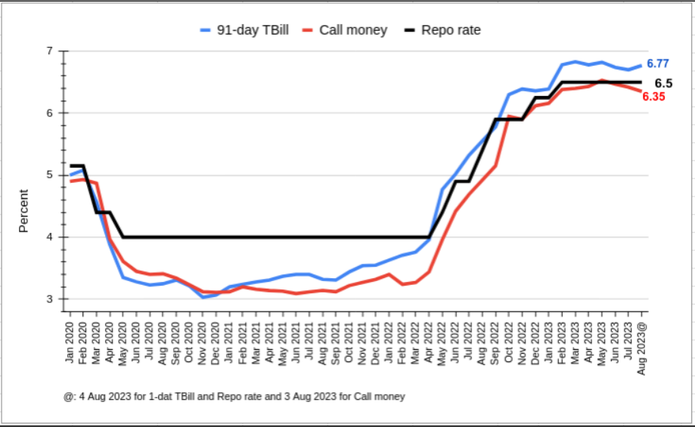
Short-term rates have risen in response to monetary policy tightening
Between May 2022 and February 2023, the RBI raised the repo rate by 250 basis points. This has driven a rise in short-term rates.
In the April, June and August policy statements, the RBI decided to maintain status quo on the policy rate.
The stance of withdrawal of accommodation has also been retained.
RBI has been conducting variable repo and variable reverse repo auctions to manage the liquidity position.

Slide 30
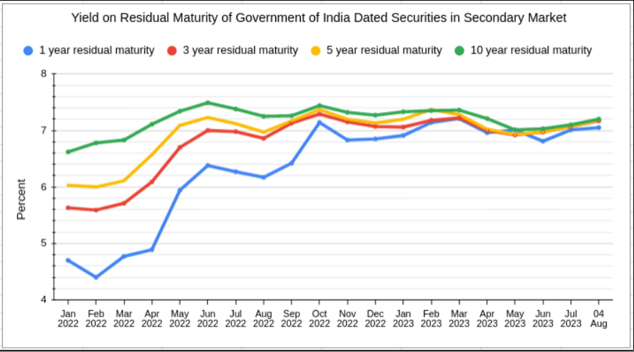
Government bond yields and spreads have converged
Convergence of government bond yields: Short term bond yields have risen faster than long term rates. Indicates flattening and on some occasions inversion of the yield curve.
Long term rates have remained steady and have moderated, possibly due to decline in domestic inflation and status quo on policy rates in the April and June policies.
However, the last few weeks have seen an upward pressure on bond yields due to a 25 basis points rate hike by the US Fed, BOE and ECB, strong US GDP data for the April-June quarter and the recent downgrade of US sovereign debt by Fitch.

Slide 31
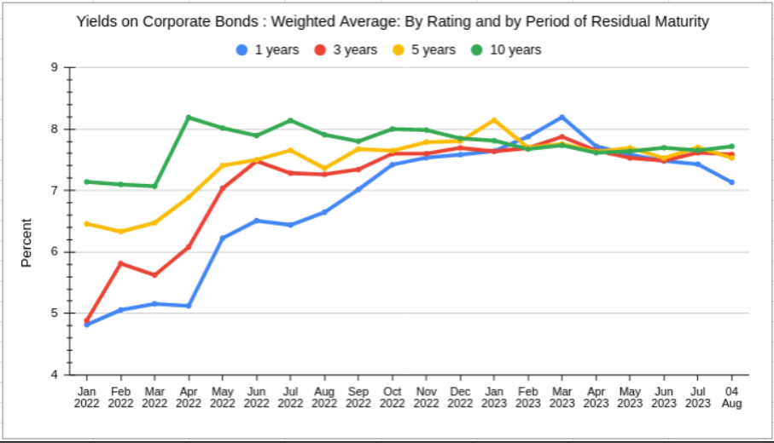
Corporate bond yields are seen to mirror trends in government bonds
Convergence of short-term and long-term corporate bond yields: Reflects demand-supply mismatch in the bond market.
Issuers are more inclined towards short-medium term bonds while investors such as pension and insurance funds are interested in investing in long-term bonds.
As an outcome, yields on short-term corporate bonds have risen faster than long-term bonds.

Slide 32
System Liquidity: Definition
System liquidity = Net borrowing under LAF - Excess reserves maintained by banks
Net borrowing under LAF = Total of all Repo/MSF/SDF borrowings - Total of all Reverse-repo deposits
Excess reserves maintained by banks = Actual reserves maintained by banks - Required reserves
If the banking system is a net borrower from Reserve Bank under LAF, the system liquidity is in deficit (i.e., system demand for borrowed reserves is positive).
If the banking system is a net lender to the Reserve Bank, the system liquidity is in surplus (i.e., system demand for borrowed funds is negative).

Slide 33
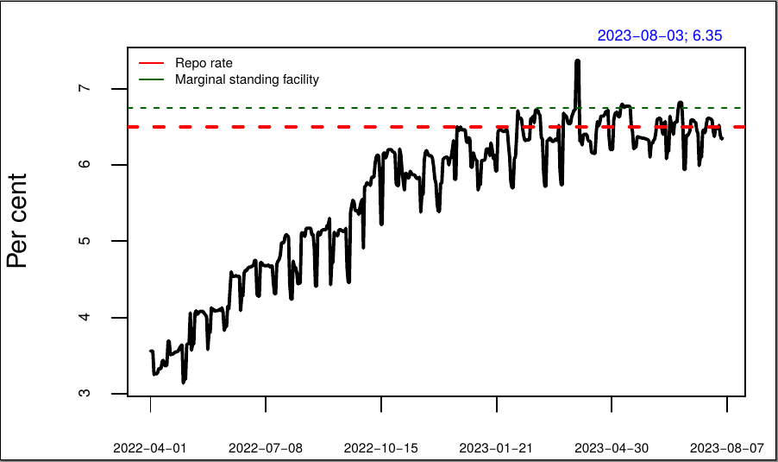
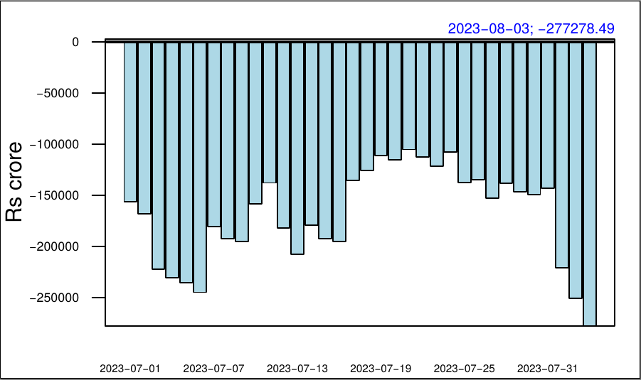
Call rate has occasionally exceeded the policy rate despite surplus liquidity
Note: Negative values indicate surplus liquidity.
Liquidity is not evenly spread across all banks; only a few banks have surplus funds.

Slide 34
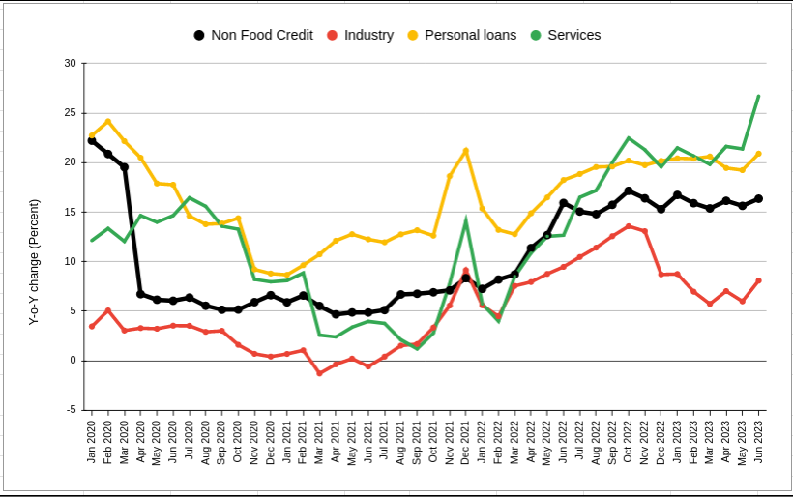
Robust credit growth despite rise in interest rates
In FY 2022-23, non-food bank credit grew by 15.4 percent despite 250 basis points rise in repo rate.
Credit to large industries as a share of GDP has seen a consistent decline since 2013-14. The ratio has declined from 18.2 percent in 2013-14 to 9.1 percent in 2022-23.
Personal loans and loans to services have been the major components of growth in non-food credit.
High credit growth continues in FY 24: Non-food bank credit grew by more than 16.3 per cent in June 2023.
Credit growth continues to surpass deposit growth. As on July 14, credit growth at 20 percent exceeded deposit growth at 13.2 percent.

Slide 35
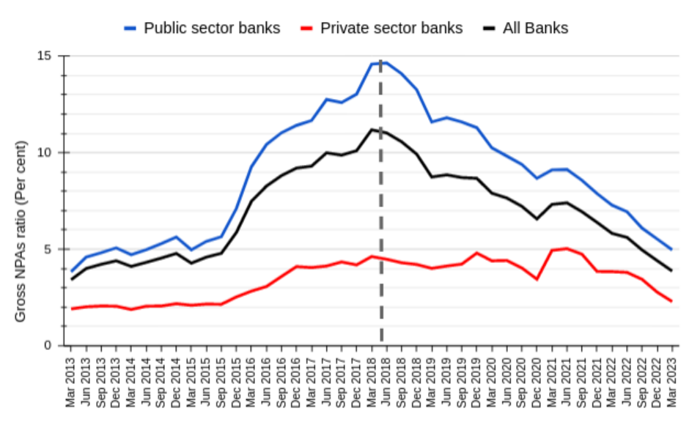
Public sector banks and private sector banks NPAs are declining and converging
Gross non-performing assets (GNPA) ratio continue declining, falling to a 10-year low of 3.9 per cent in March 2023.
This is a sharp decline from 11 percent GNPA ratio in June 2018.
In particular, public sector banks GNPA ratio declined from 14.64 percent in June 2018 to 5 percent in March 2023.

Slide 36
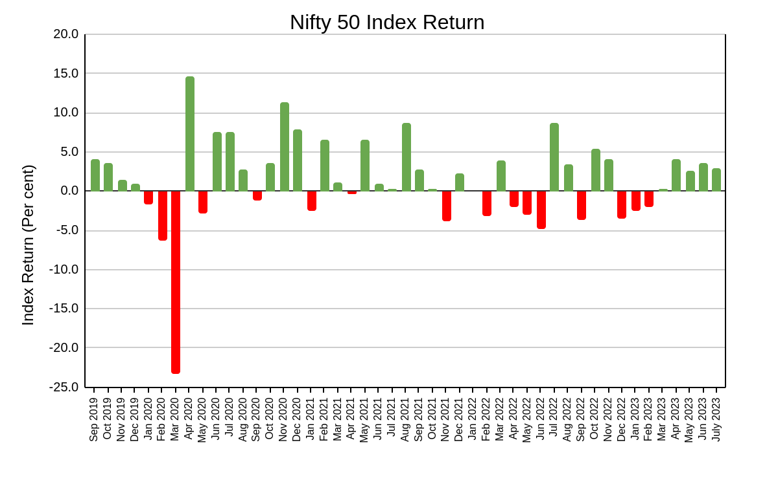
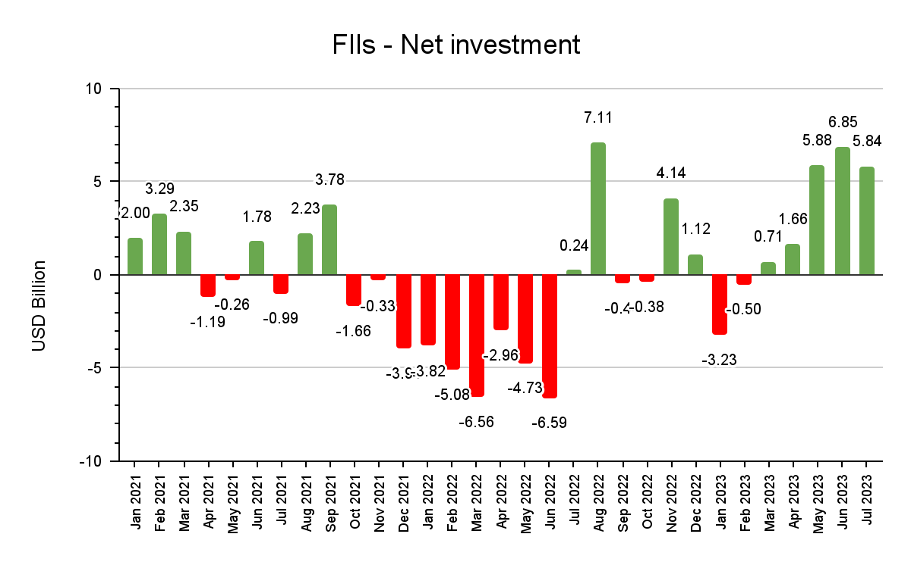
Buoyant capital market led by FPI net buying since March, now adversely affected by Fed rate hike & recent Fitch downgrading of US sovereign debt
NSE Nifty 50 registered positive returns in recent months due to moderation in global inflation, though it has declined during the past week due to downgrade of US sovereign debt by Fitch.
FPIs were net buyers for the fifth month in row. Though less than the net investment in June 2023, FPIs net investment was as much as USD 5.67 billion in July.
The 25 bps rate hike by the Fed on July 28 and the recent downgrade of US sovereign debt by Fitch has adversely affected FPI buying in the last week of July and early August.

Slide 37
How is India doing? Key takeaways from the panel discussion:
Growth, inflation & balance of payments
Fiscal Performance
Monetary policy and financial markets

Slide 38
Growth, inflation & balance of payments
Slowdown in H2: 2022-23 due to fading base effect + reduced growth of consumption & investment demand
Slowdown seen mainly in services
Growth may decline from 7.2% in 2022-3 to 6% in 2023-24
2023-24 Q1 industrial growth buoyant (especially construction & consumer non-durables
However, Q1 agricultural growth muted
Monthly indicators also suggest sluggish Q1 services growth
-------------------------------------------------------------------------------------------------------------------------------------------------------
Inflation now below RBI tolerance band upper limit of 6%
Broad based decline in food, energy and core inflation
Inflation forecast at 5.1% for 2023-24
-------------------------------------------------------------------------------------------------------------------------------------------------------
Current account deficit contracted to 0.2% GDP in H2: 2022-23 the goods trade deficit fell & service trade surplus increased
CAD started widening again in Q1: 2023-24 as goods trade deficit increased & the services trade surplus contracted
Capital inflows declined from $49 billion in HI: 2022-23 to $19 billion in H2: 2022-23, fall in reserve assets & FPI, volatile FDI
FDI recovered & FPI peaked in Q1:2023-24
Nominal exchange rate & REER stable during 2022-23 with rising forex reserves, now equal to 10 months imports

Slide 39
Fiscal Performance
Key features of fiscal performance are buoyant tax revenues since 2019-20, except central tax receipts in Q1 2023-24, continuing thrust on capital expenditure, fiscal consolidation
Central tax revenues all buoyant (>1) except excise duties, in particular monthly GST receipts now Rs. 1.5 trillion or more. But sharp decline in tax revenue growth in Q1 2023-24.
Central Capex rose by 24% in 2022-23 & budgeted to rise by 37% in 2023-24 but revenue expenditure will grow by only 1%
Allocation for 50 year, zero interest capex loan to states raised from Rs 1 trillion in 2022-23 to Rs 1.3 trillion in 2023-24
State governments: large variations, but on average robust OTR growth of 19% against 7% growth in central transfers
Earlier, devolution dominant component of transfers, now grants larger than devolution in all except 8 states
States’ capex performance modest despite central support. However, indications of large increase in Q1 2023-24
States’ fiscal deficit 2.8% in 2022-23, set at 3.2% for 2023-24
States on track to meet 15th Finance Commission target
Centre also consolidating, 2022-23 FD target 6.4% was met, 2023-24 target 5.9%, but goal of 4.5% by 2025-26 challenging

Slide 40
Monetary policy and financial markets
REPO rate raised by 250 basis points since May 2022 to 6.5% in February 2023 + other monetary policy tightening measures
In response, call money rates have risen, closely tracking or even exceeding the policy rate despite surplus liquidity
Short term & long term government bonds yields have converged.
This is mirrored by a faster increase in short term corporate bond yields compared to long term bond yields
Credit growth has been robust despite rising interest rates.
Personal loans and loans to services has led credit growth, while credit growth to large industry has been modest
Meanwhile banks NPAs have been declining, and declining faster for public sector banks, which had higher NPAs.
Capital market has been buoyant in Q1: 2023-24, mainly thanks to large buying by FPIs
But advanced countries rate hikes, crude price resurgence & recent downgrade of US sovereign debt could reverse this

Slide 41
Thank You

Slide 42
Appendix

Slide 43
4.1: Sharp decline in Q1 2023-24 tax revenue growth; expenditure in line with budget estimates
Revenue Collections April-June 2023 - Percent change
Q1-2023-24 growth in GTR modest at 3%
GTR growth budgeted at 10.4% in 2023-24
Income tax and GST registered double digit growth
Corporation tax growth fell by 14%
- attributed to tax refunds
Excise duties fell by 15% on account of softening oil prices
Q1 numbers not reflective of the likely annual trend
Revenue expenditure almost flat
In contrast sharp increase in capex (59%)
Trends in expenditure in line with budget estimates for 2023-24
Indicators | Y-o-Y change (%) Apr-June 2022 | Y-o-Y change (%) Apr-June 2023
Centre’s Net Revenue | 5.2 | 3.6
Gross Tax Revenue (GTR) | 22.4 | 3.3
- Corporation Tax | 30.0 | -13.9
- Income tax | 40.7 | 11.1
- Excise duties | -9.8 | -15.4
- Central GST | 52.7 | 15.0
- Customs duty | -11.8 | 34.9
Non-Tax Revenue | -51.2 | 149.3
Expenditure April-June 2023 - Percent change
Indicators | Y-o-Y change (%) Apr-June 2022 | Y-o-Y change (%) Apr-June 2023
Revenue Expenditure | 8.8 | -0.1
Capital Expenditure | 57.0 | 59.0
Total Expenditure | 15.4 | 10.8

Slide 44
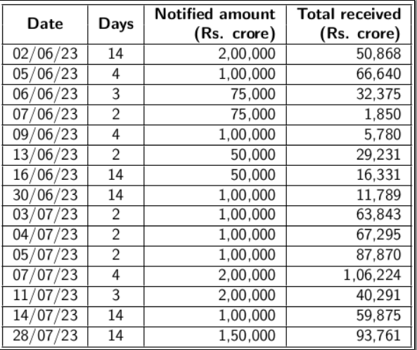
5.1: Muted response of banks to Variable Rate Reverse Repo (VRRR) auctions

Slide 45
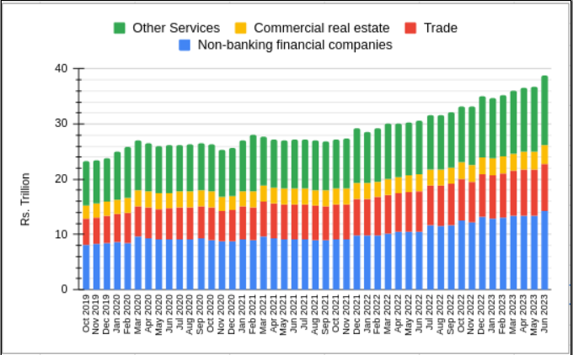
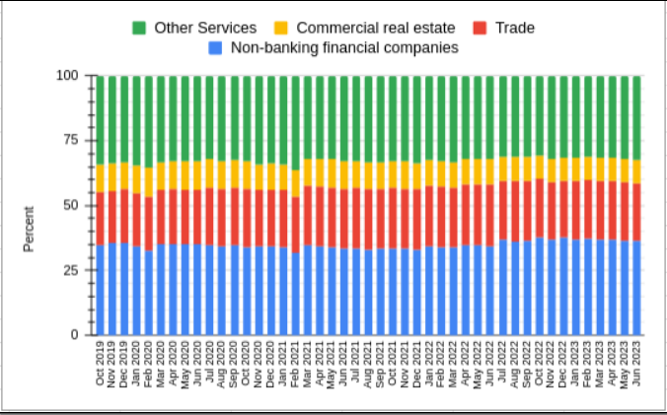
5.2: Credit to services
Outstanding credit to services sector
Share in credit to services sector
The outstanding credit to Services sector in June 2023 stood at Rs. 38.85 trillion, a growth of 26.7 percent from June last year. Of the total outstanding credit to services, credit to NBFCs and domestic trade stood at Rs. 14.24 trillion and Rs. 8.6 trillion respectively.
Credit to Non bank financial companies (NBFCs) has a share of 36.7 percent and trade has a share of 22.1 percent in the outstanding credit to services sector.
Reliance on bank funding has increased for NBFCs as other sources of funds such as Mutual Funds (MF) exposure to the bonds and CPs of NBFCs has seen a decline.
Other Services includes Transport operators, Computer software, Tourism, hotels & restaurants, Professional services, Shipping, Aviation and Other services

Slide 46
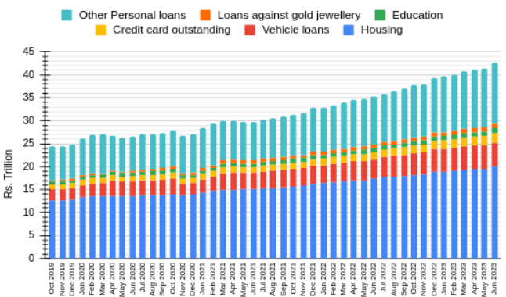
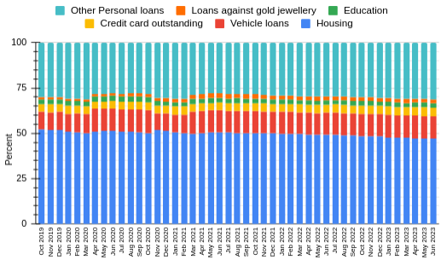
5.3: Personal loans
Outstanding personal loans
Share in personal loans
The outstanding credit to Services sector in June 2023 stood at Rs. 38.85 trillion, a growth of 26.7 percent from June last year. Of the total outstanding credit to services, credit to NBFCs and domestic trade stood at Rs. 14.24 trillion and Rs. 8.6 trillion respectively.
Credit to Non bank financial companies (NBFCs) has a share of 36.7 percent and trade has a share of 22.1 percent in the outstanding credit to services sector.
Reliance on bank funding has increased for NBFCs as other sources of funds such as Mutual Funds (MF) exposure to the bonds and CPs of NBFCs has seen a decline.
Other Services includes Transport operators, Computer software, Tourism, hotels & restaurants, Professional services, Shipping, Aviation and Other services

